Slide 1





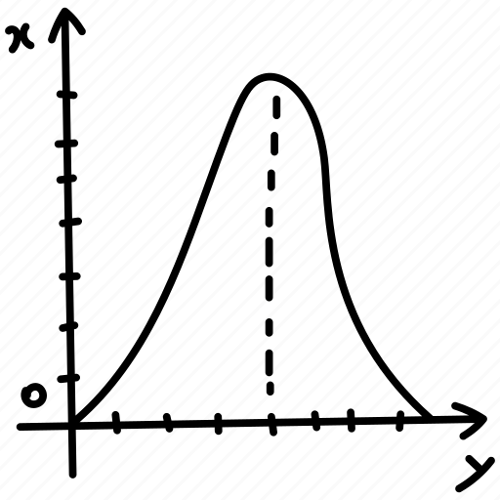
Title : Empowering Data Communication with 5G Technology
Course title : Theory of Computation
Course code: CSE_228

Slide 2
Submitted To,
Submitted by,
Name: Md Nazmul Islam
ID:0242310005101183
Section: 64_B
Department of CSE
Daffodil International University
Professor Dr. Md. Fokhray Hossain
Professor, Department of Computer Science & Engineering (CSE)
Daffodil International University

Slide 3
Empowering Data Communication with 5G Technology
Course title : Data Communication
Course code: CSE_225

Slide 4


Introduction: 5G is the fifth generation of wireless technology that promises faster internet speeds, lower latency, and improved capacity. It is designed to support the growing number of devices and applications.

Slide 5
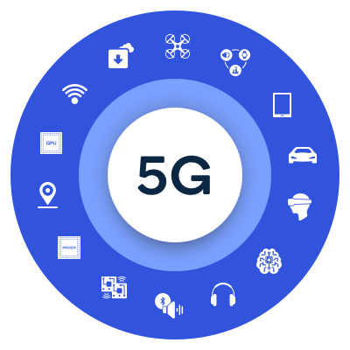
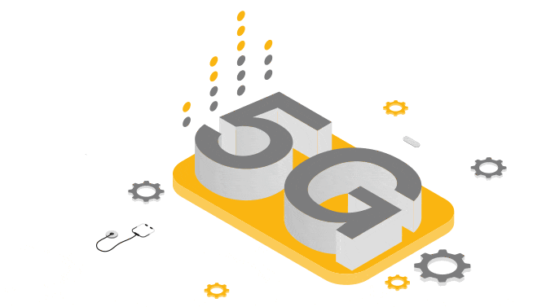
Understanding 5G:
Definition: 5G, short for fifth generation, is the latest standard in mobile networking technology, succeeding 4G LTE.
Key Objectives: Designed to provide faster data speeds, lower latency, increased device connectivity.
Advantages of 5G over 4G:
Speed: 100 times faster.
Latency: Less delay when data is sent or received.
Capacity: Can handle more devices and more data at the same time.

Slide 6
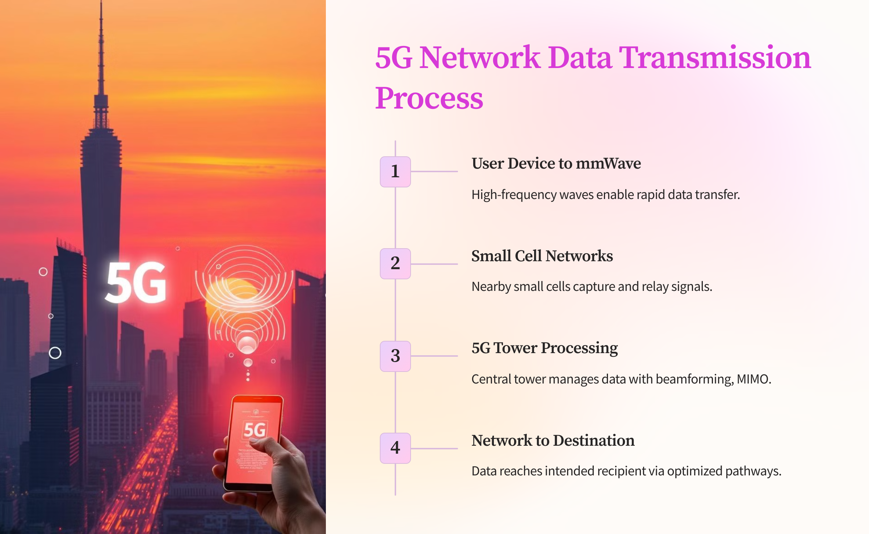
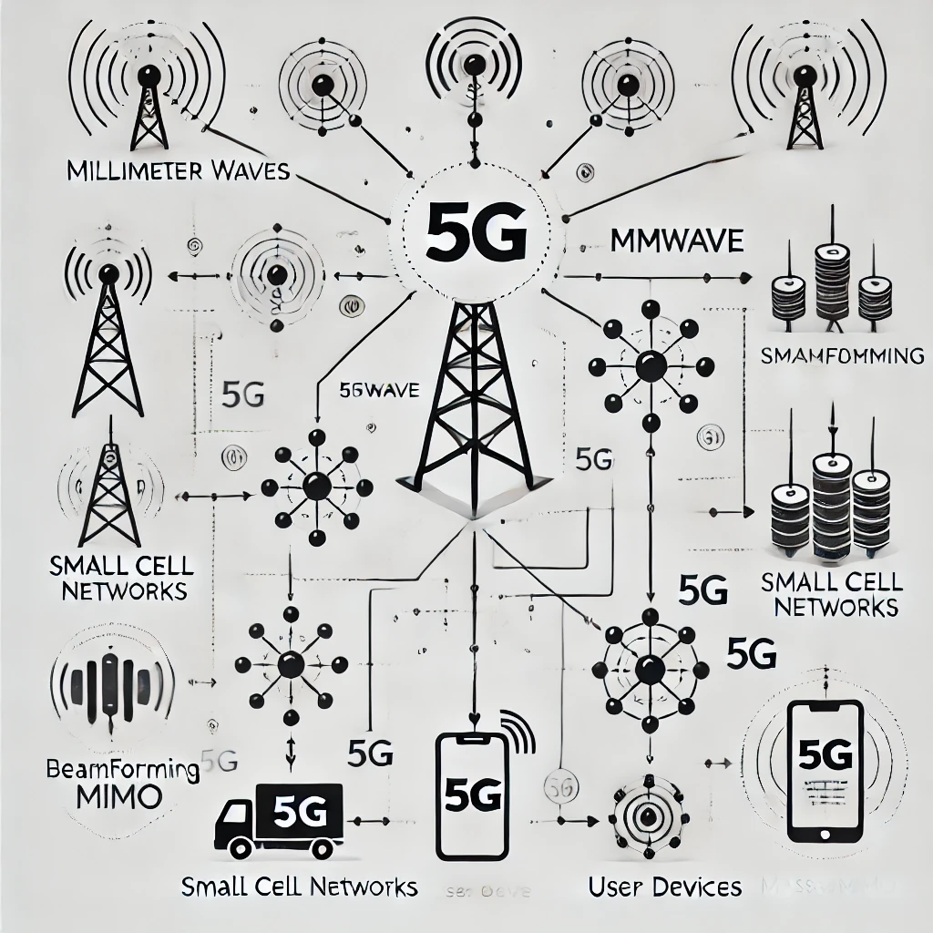

Slide 7

Future Trends in 5G Communication
Wi-Fi 6 and Beyond: Offers faster speeds, better capacity, and improved performance in crowded environments.
6G Technology: Expected to surpass 5G with even faster speeds and wider applications.
Li-Fi (Light Fidelity): Uses light to transmit data at extremely high speeds.

Slide 8
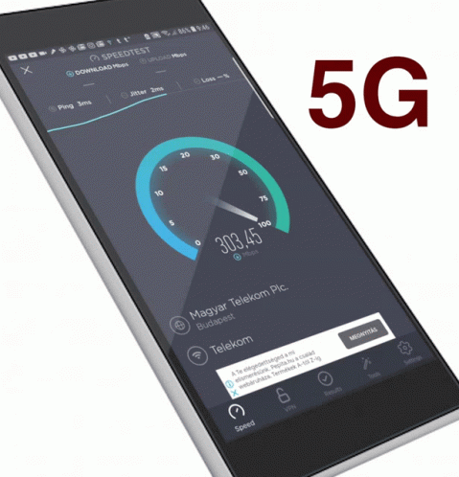
Challenges and Limitations:
Infrastructure Costs:
Requires significant infrastructure upgrades, which can be costly and time-consuming for service providers.
Coverage and Interference:
5G signals have shorter range
Are easily blocked by obstacles, which can limit coverage.
Compatibility with Existing Infrastructure:
The adoption of 5G may require updates to existing infrastructure, which can be difficult and expensive for organizations with older technology systems.

Slide 9

Conclusion:
5G technology is not just about faster internet on our phones.
It's a game-changer, bringing quicker speeds, almost instant connections, and the ability to connect a massive number of devices.
It is connecting us to innovations like self-driving cars and smart cities.
As it continues to roll out worldwide, its impact on how we connect and communicate is set to be revolutionary.

Slide 10
References:
[1] “Qualcomm”, <<https://www.qualcomm.com/5g/what-is-5g>> last accessed 30 October 2024, at 7:27 pm.
[2] “Cisco”, <<https://www.cisco.com/c/en/us/solutions/what-is-5g.html>> last accessed 30 October 2024, at 9 pm.
[3] “TechTarget”,
<<https://www.techtarget.com/searchnetworking/feature/A-deep-dive-into-the-differences-between-4G-and-5G-networks#:~:text=The%20biggest%20difference%20between%204G,such%20as%20faster%20download%20speeds.>> last accessed 29 October 2024, at 6.51 pm.
[4] “Youtube”, << https://www.youtube.com/watch?v=mo1lNRKnayA >> last accessed 30 October 2024, at 11.58 pm . From “3.88 to 6.10” second

Slide 11
Thank You

